Slide 1
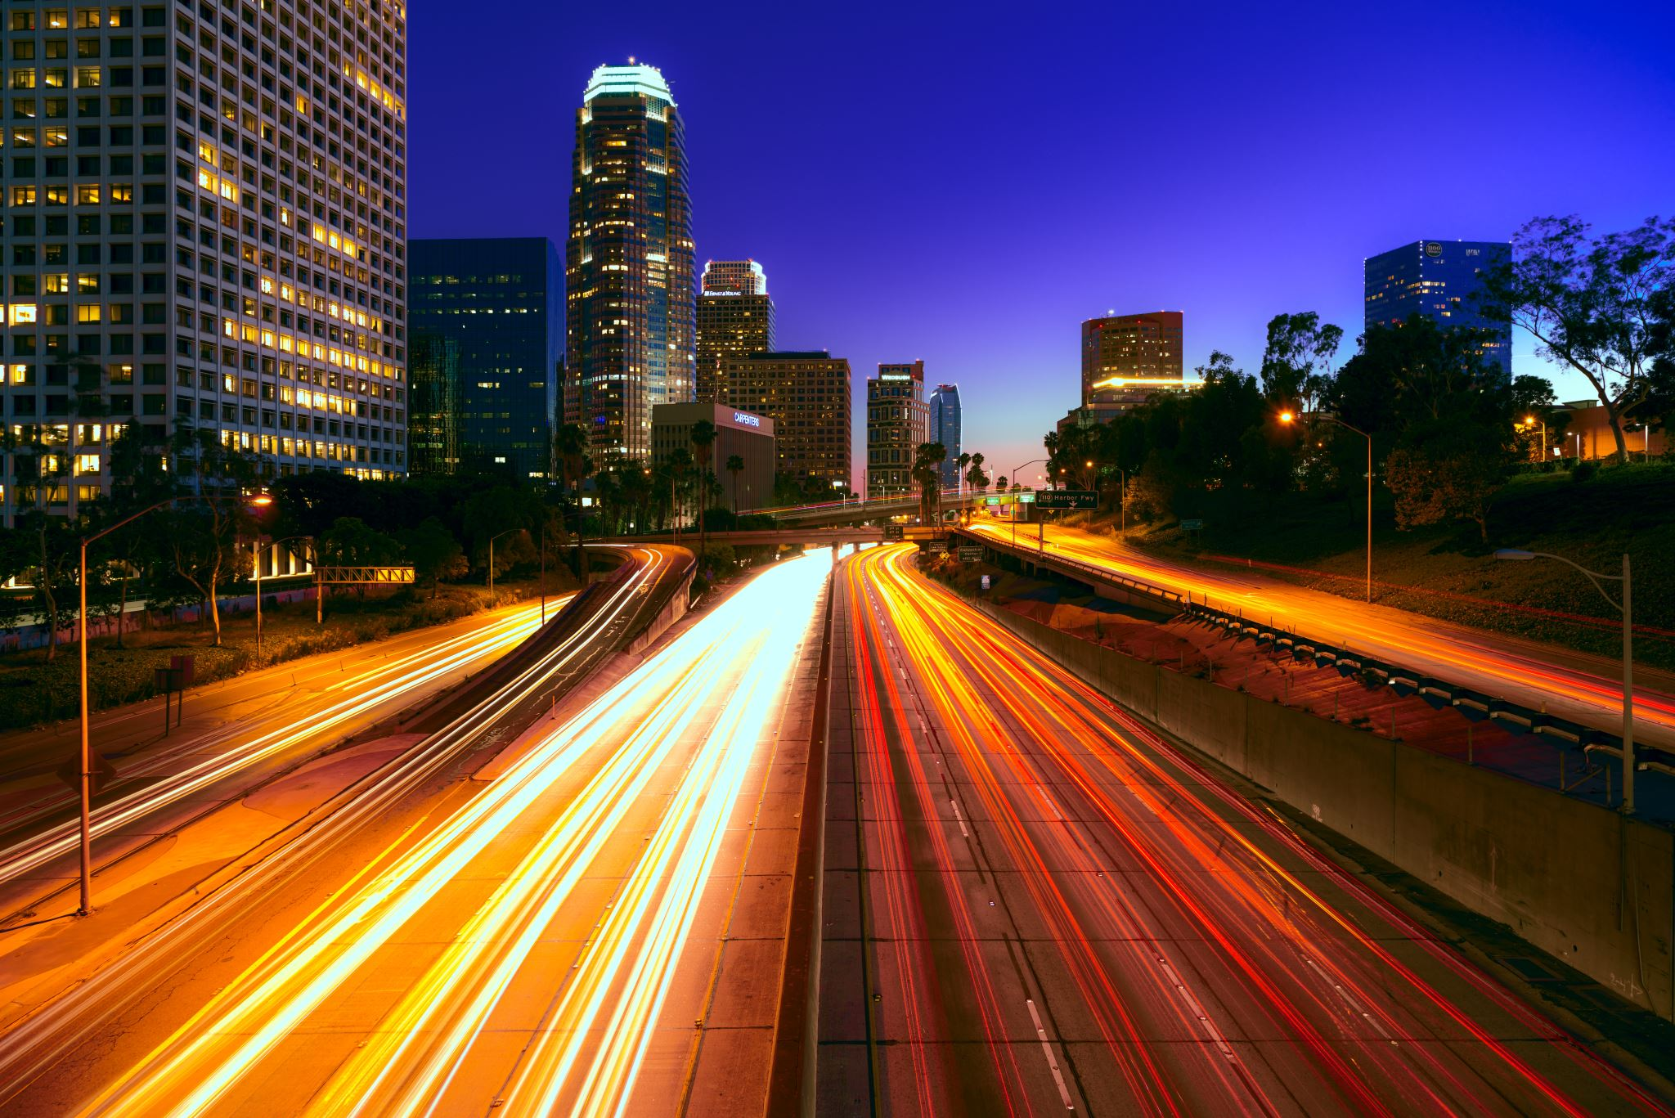
Analysis of Traffic Collisions in LA County
Armine Grigoryan
Lucine Mkrtchyan
Nicole nguyen

Slide 2
Data
2010-2019
Traffic collisions across LA County
Limitations:
Transcribed from actuals reports
Some fields missing
Kaggle:
https://www.kaggle.com/cityofLA/los-angeles-traffic-collision-data
Origin website
https://data.lacity.org/A-Safe-City/Traffic-Collision-Data-from-2010-to-Present/d5tf-ez2w
Notes:
Our project analyzed multiple factors attributing to motor vehicle accidents. We examined the relationships between the number of accidents against various circumstances and influences.
We found our data from Kaggle, but it originates from data.lacity.org
The goal of the website is to increase transparency for the public in hopes to drive innovation and problem solving for the city
This particular data set we found spans across the past 10 years
It contains data on reported traffic collisions all around LA county
<insert>
Limitations:
- Since this data was transcribed from actuals reports, there may be some inaccuracies do due human error.
Some data may have not been recorded; therefore, resulting in blank items in our data
<insert>

Slide 3
Challenges
Formatting
Broken links
Mapping data codes
Speed bumps along the way…
Notes:
Before starting our analysis, each of us had to overcome some challenges with formatting:
Formatting the date columns
<insert>
Difficulties with dataset:
Some columns related to links that didn’t work
Example: what is an MO Code?
We had to search the data to map it and create a race dictionary from the alphabetical letter codes
<insert>

Slide 4
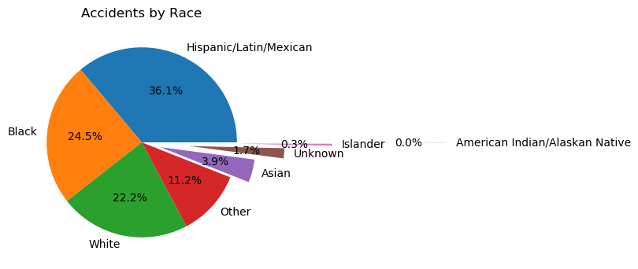
Notes:
I hope you guys are hella hungry! Because we’re about to feed you a lot of bars and pies!
Cliché assumption: Asians are bad drivers
Question: Are Asians bad drivers?
Analysis: In this sample population from LA County, Hispanic/Latin/Mexican had the highest percentage of accidents occurring in the 10 year dataset. The race demographic in Southern regions of California is primarily Hispanic, whereas the Bay Area is primarily asian. If the sample was taken from a population whose density was evenly spread, then the sample could be more conclusive.
The percentage for some of the race demographics were so low that displaying them caused an overlap in text. The pie chart was exploded in a way to make each part readable. Although a bar chart would have been better for this data, the pie chart looked unique in the way it was exploded

Slide 5
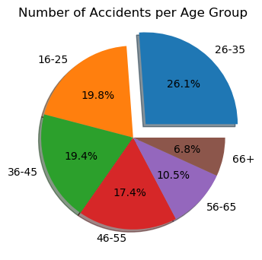
Notes:
Question: Are younger drivers more at risk of causing accidents?
Analysis: The ages were binned into ranges to make the dataset more manageable and then analyzed. The assumption was the younger age range would have a higher count of accidents. It was found that those within the age range of 26-35 had the highest number of accidents amongst the other age groups, although the fair amount of . Other factors that could contribute to this is the population density of 26-35 year-olds.

Slide 6
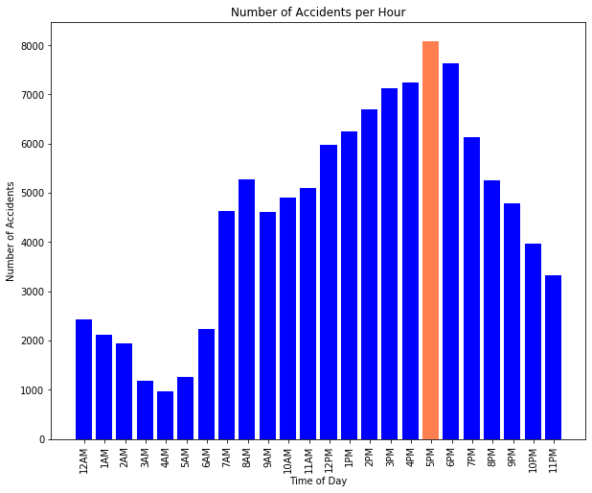
Notes:
Question: Are accidents most frequent around rush hour?
Analysis: We compared every hour of the day to see which hour held the most reported collisions. Analysis shows that 5pm is the time in which most accidents occurred with other high number of accidents between 3-6pm. Rush hour occurs between 3-7pm. 5pm would be the peak of rush hour.

Slide 7
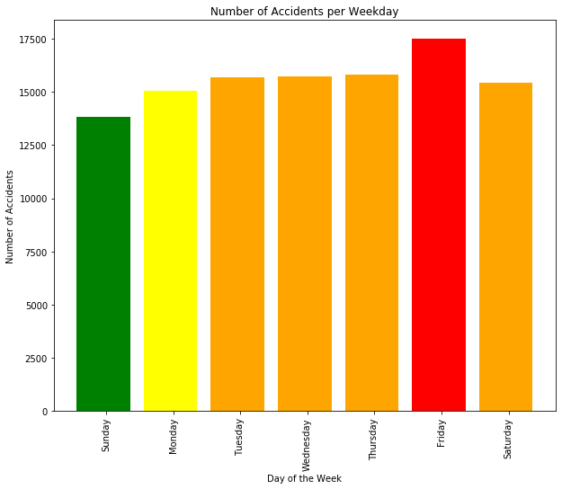
Notes:
Question: Which day of the week is more prone to accidents?
Analysis: Our assumption was that a week day would have the highest rates of reported collisions because of work schedules. Analysis shows that Friday was the day where most accidents occurred.

Slide 8
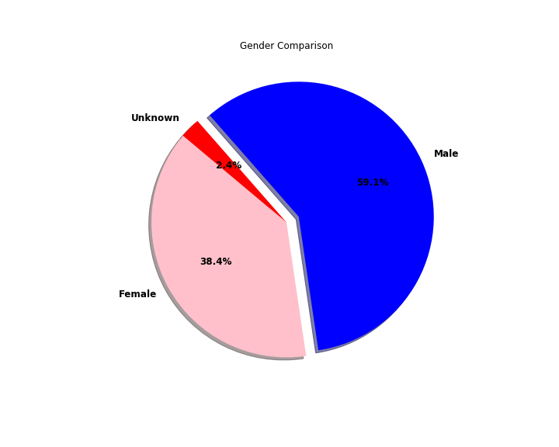
Notes:
Question:
Analysis:

Slide 9
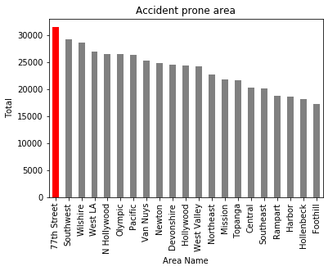
Notes:
Question:
Analysis:

Slide 10
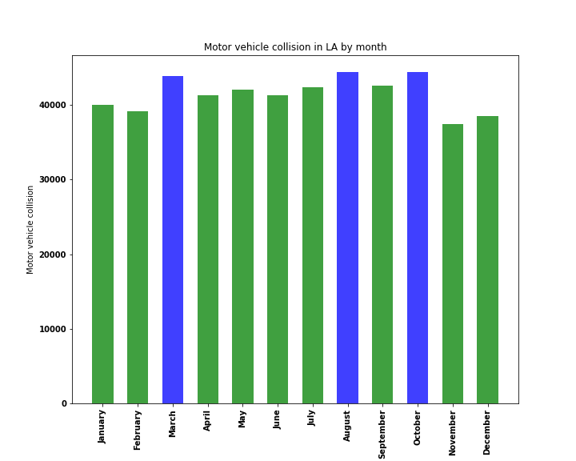
Notes:
Question:
Analysis:

Slide 11
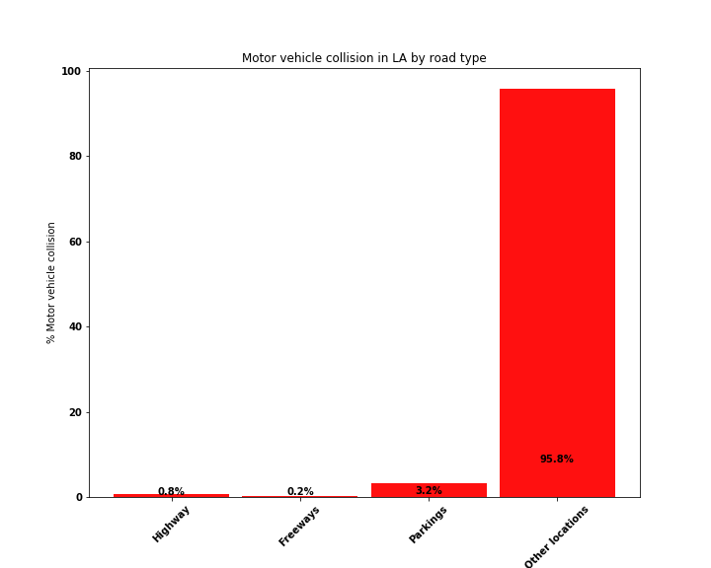
Notes:
Question:
Analysis:

Slide 12
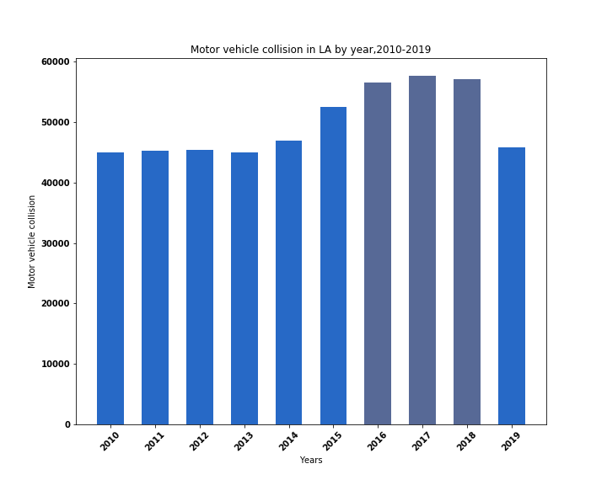
Notes:
Question:
Analysis:

Slide 13
Conclusion
Final thoughts…
Notes:
This project was fun because we got to use our skills and create something of our own
<insert>
-
- Weekdays during rush hour seem to the highest risk time to be on the road.
<insert>

